Slide 1
The battle of the neighbourhoods
Toronto vs. New York City

Slide 2
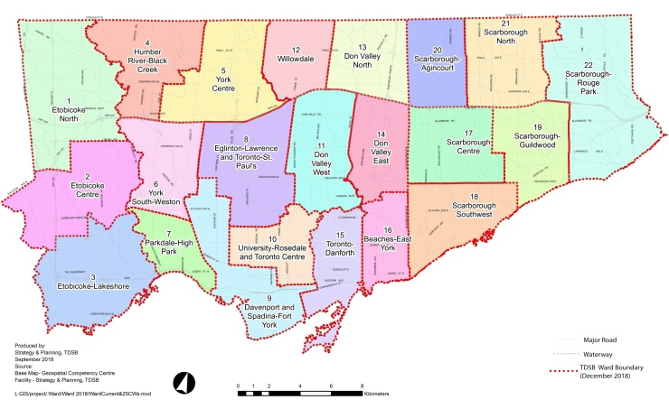
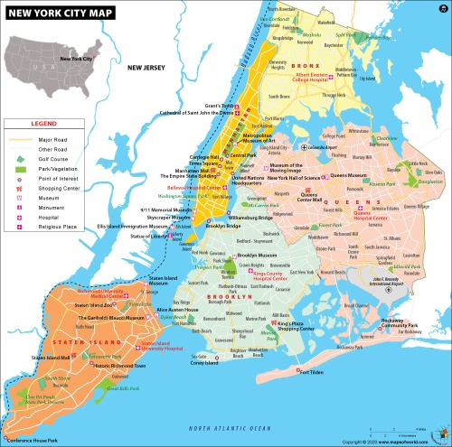
INTRODUCTION
TORNOTO
7 Million Population
13th Best City
Well diverse in institutions, attractions, infrastructures and restaurants and well known for it’s rate of immigrations and educational attainments.
NEW YORK CITY
20 Million Population
2nd Best City
Well diverse in arts, culture, entertainment, shopping, restaurants and well known for it’s night life.

Slide 3
BUSINESS PROBLEM
Invest to launch a new set of branches of a famous Asian Restaurant Chain.
Geographical distribution of restaurants in Toronto & New York City.
Prevalence of Covid-19 pandemic in neighbourhoods.

Slide 4
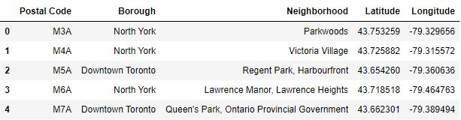
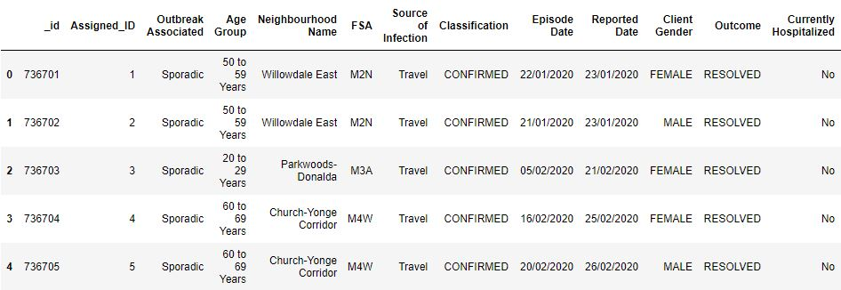
DESCRIPTION OF DATA
Toronto Neighbourhood Data
Toronto Covid-19 Data

Slide 5
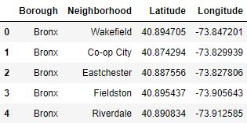
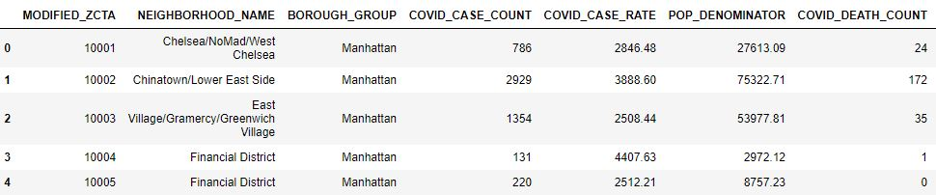
DESCRIPTION OF DATA
New York City Neighbourhood Data
New York City Covid-19 Data

Slide 6
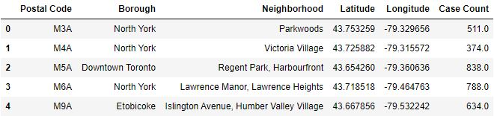
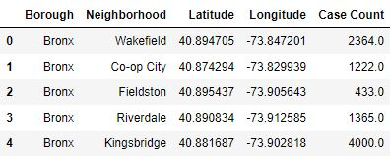
METHODOLOGY
Aggregated Data
Toronto
New York City

Slide 7
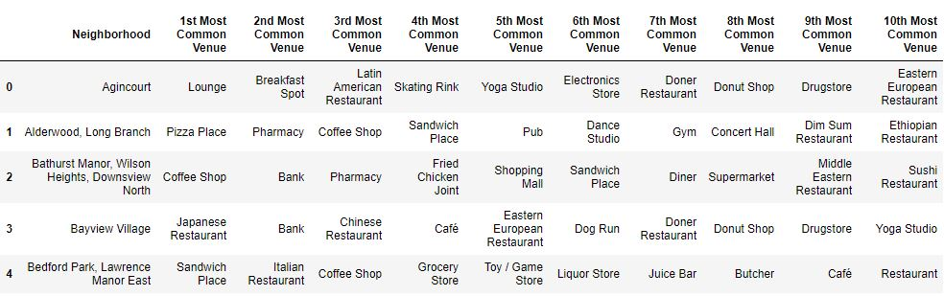
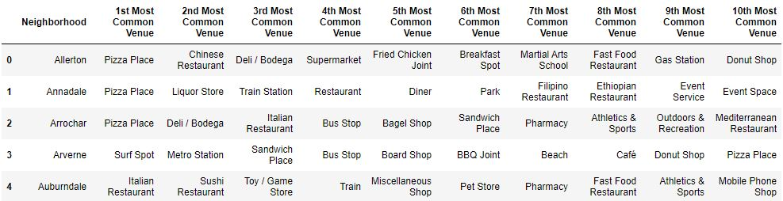
METHODOLOGY
Explore Neighbourhoods
Toronto
New York City

Slide 8
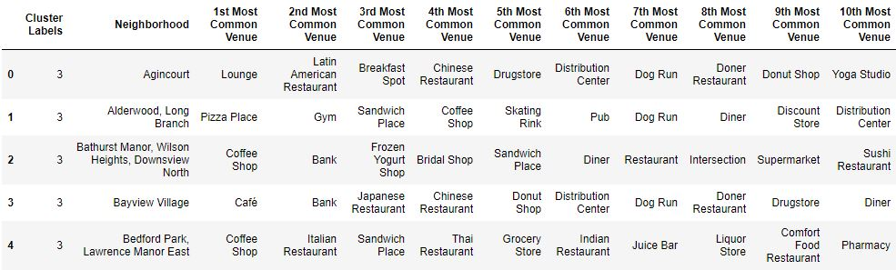
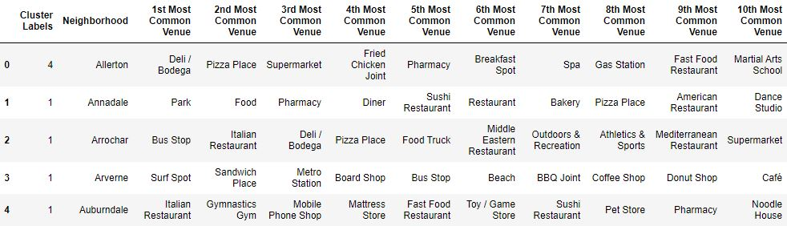
METHODOLOGY
K-Means Clustering
Toronto
New York City

Slide 9
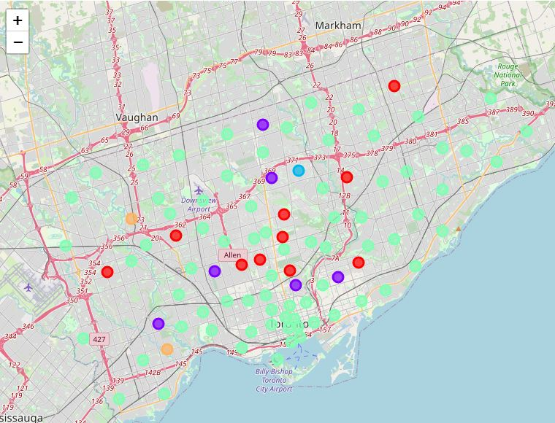
RESULTS
Toronto

Slide 10
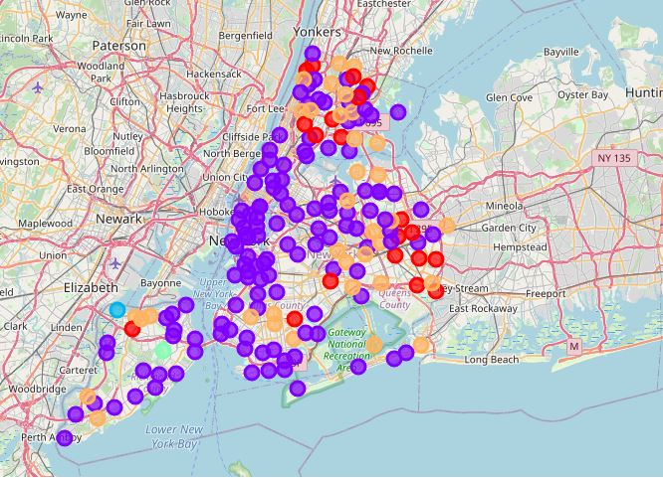
RESULTS
New York City

Slide 11
DISCUSSION
Toronto
CLUSTER | NATURE | NUMBER OF NEIGHBOURHOODS | AVG COVID-19 CASES PER NEIGBURHOOD
Cluster 1 | Recreational cluster with parks, trails, swimming pools, hockey arenas, playgrounds with a few Asian Restaurants. | 10 | 505
Cluster 2 | Fitness cluster with yoga studios, parks, playgrounds, pools with no Asian Restaurants | 6 | 374
Cluster 3 | A mixed cluster with ample recreation centres, restaurants and other stores. | 1 | 93
Cluster 4 | The largest cluster with many banks, cafes, supermarkets and Japanese, Italian, Thai, Korean, Mexican restaurants. | 74 | 687
Cluster 5 | Services cantered cluster with a few Eastern European Restaurants and drug stores. | 2 | 664

Slide 12
DISCUSSION
New York City
CLUSTER | NATURE | NUMBER OF NEIGHBOURHOODS | AVG COVID-19 CASES PER NEIGBURHOOD
Cluster 1 | Food cluster with a range of restaurants, food trucks, bakeries, cafes, pizza shops and ice cream shops | 20 | 1930
Cluster 2 | The largest and the competitive cluster with different types of restaurants, recreation centres and service centres | 124 | 1685
Cluster 3 | The entertainment cluster with a bar, yoga studio, event service, exhibit and an Ethiopian Restaurant. | 1 | 570
Cluster 4 | Fit & Food cluster with a park, trail and different set of restaurants | 1 | 1495
Cluster 5 | Pizza cluster with a large number of pizza shops and a range of recreational activity centres | 35 | 1895

Slide 13
CONCLUSION
Prevalence of Covid-19 pandemic has to be considered when prioritizing clusters and neighbourhoods in each city.
CITY | PRIORATISED CLUSTERS | DEPRIORATISED CLUSTERS
Toronto | Cluster 2 & Cluster 1 | Clusters 3, 4 & 5
New York City | Cluster 5 & Cluster 3 | Clusters 1, 2 & 4

Slide 14
REFERENCES
https://www.toronto.ca/home/covid-19/covid-19-latest-city-of-toronto-news/covid-19-status-of-cases-in-toronto
https://open.toronto.ca/catalogue/?search=Covid%2019&sort=score%20desc
https://open.toronto.ca/dataset/covid-19-cases-in-toronto/
https://docs.ckan.org/en/latest/api/index.html
https://www.nytimes.com/interactive/2020/nyregion/new-york-city-coronavirus-cases.html#zipcode
https://www1.nyc.gov/home/search/index.page?search-terms=COvid+CAses
https://www1.nyc.gov/site/doh/covid/covid-19-data-totals.page#zip
https://github.com/nychealth
https://github.com/nychealth/coronavirus-data/tree/master/totals
https://en.wikipedia.org/wiki/List_of_postal_codes_of_Canada:_M
https://www.coursera.org/learn/data-analysis-with-python/home/welcome.
https://www.coursera.org/learn/python-for-applied-data-science-ai/home/welcome
https://www.coursera.org/learn/python-for-data-visualization/home/welcome
https://www.coursera.org/learn/applied-data-science-capstone/home/welcome

Slide 15
THANK YOU

